Slide 1
Thataway
No, not that way, thataway!
Team Catdog
Nicholas Chaput
Bailey Sheridan

Slide 2
Summary & Features
In “Thataway”, the player attempts to solve puzzles in the form of a hidden path spanning the full game board. After each attempt, the game will provide feedback which the player can use to refine their solution. Players can mark tiles to keep track of the information they have already discovered. Levels will be randomly generated for endless gameplay.
Endless randomly generated levels
Solution feedback system
Sound effects
Tile marking system
Multiple difficulty levels

Slide 3
Play Description
The player clicks and drags across beads to form a path that covers the entire board. When they release, any beads from which they went the wrong direction are marked red. The player can mark any beads they wish with arrow glyphs after the tutorial by clicking, as a reminder of what directions are correct.

Slide 4
Target Audience & Experience Goals
Target Audience
Ideal Player
Limited free time
Needs something they can play in short bursts for a few minutes
Needs to be able to look away from the game without penalty
Appropriate for all ages
Experience Goals
Levels take two minutes or less once a player knows the rules
Curiosity & satisfaction

Slide 5
Analytics
Number of moves per level
One move being a click, drag, and release
Time per level
Number of levels completed

Slide 6
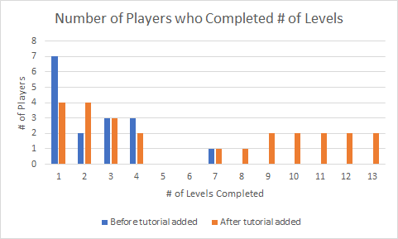

Slide 7
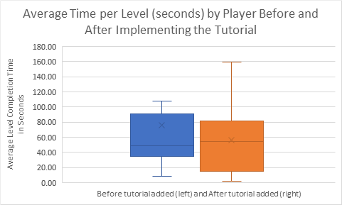

Slide 8
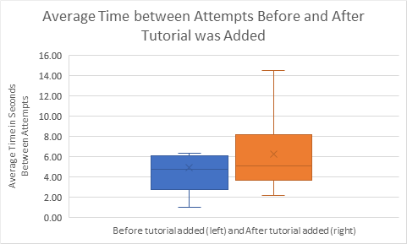

Slide 9
Playtesting & Survey
Playtesting
Players needed our help to interpret the rules from the cover image
Didn’t understand that the direction you left each bead mattered
Didn’t understand that you had to fill the entire board
With larger levels, players felt it was too much information to remember
Players were misled by having a unique color for the start of their path
Survey
All of the above
Puzzles are too difficult (66% marked the difficulty as 4/4)
Suggested the use of glyphs to alleviate various problems

Slide 10
Changes from Playtesting and Survey
First tile in the player’s attempt no longer has a unique color
Added a tutorial to explain the rules one at a time
Glyphs used in the first two levels to reinforce the idea that direction matters
Carefully teach the player new things by updating the status bar as they play these levels
After the tutorial, the player is now able to mark tiles with glyphs by clicking them
4 directional arrows and an 4-point star.

Slide 11
Class Critique
Notes
Too much information/instruction on the cover; difficult to remember in-game
Difficulty curve is too slow
The instructions for marking tiles was missed; the feature was brought up as a bug
Changes made in response
Removed all instructions from the cover image
Each difficulty now lasts one less level before the next one begins
Reworked the instructions for marking tiles to be more straightforward

Slide 12
Demo!

Slide 13
Thank you!

